Slide 1
National Workshop on Integrated Water (BASIN) Resources Management (IWRM)
River Basin Managers Perspective
Don Blackmore | 2 February 2015
Former CEO Murray Darling Basin Commission—Chairman of eWater and IWMI
New Delhi

Slide 2
Integrated Water (BASIN) Resources Management is a Business
Notes:
Add map background

Slide 3
The reform agenda
Policy | Institutional | Instruments | Tools
Notes:
Add map background

Slide 4
Evolution of Water Management
Pioneering and Discovery Phase 1880 – 1920
Delivery Phase 1920 – 1985
Management Phase 1985 – Present

Slide 6
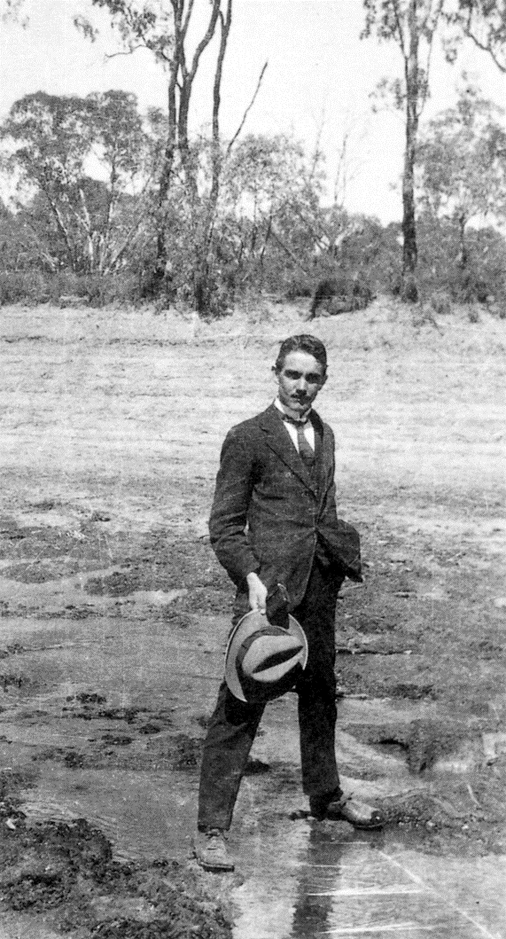
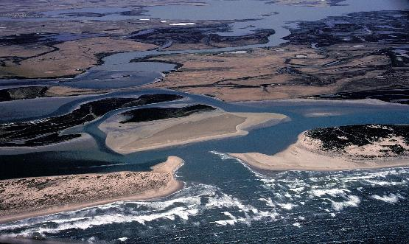
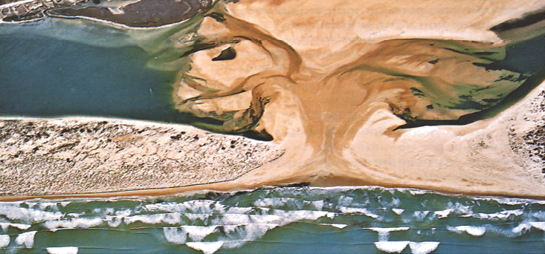
Commissioner, Sir Ronald East straddling the River Murray at Nyah, Victoria during the drought of 1923
Notes:
MURRAY MOUTH
. THE MURRAY MOUTH IS A CONVENIENT WAY OF AGREGATING THE OVERALL CHANGE IN WATER MANAGEMENT IN THE BASIN. WE NOW HAVE EXTENDED PERIODS 2-6 MONTHS IN EACH YEAR WHEN THERE IS NO WATER LEAVING THE BASIN.

Slide 7
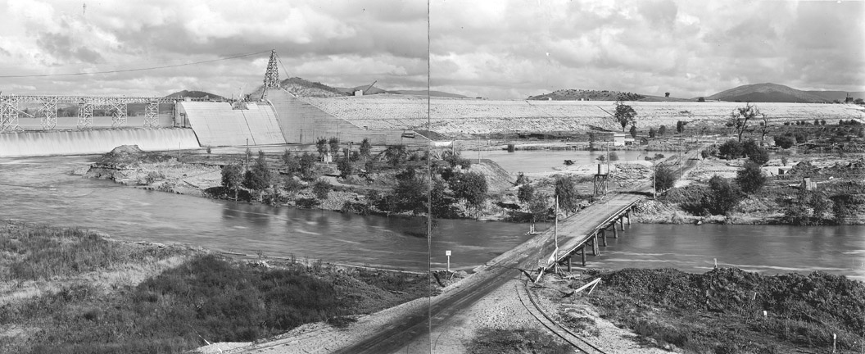
Notes:
Massive engineering undertakings were commissioned. At the time Hume Dam was the second or third largest on earth. A significant achievement for such a small nation. Notice the bare hills.

Slide 8
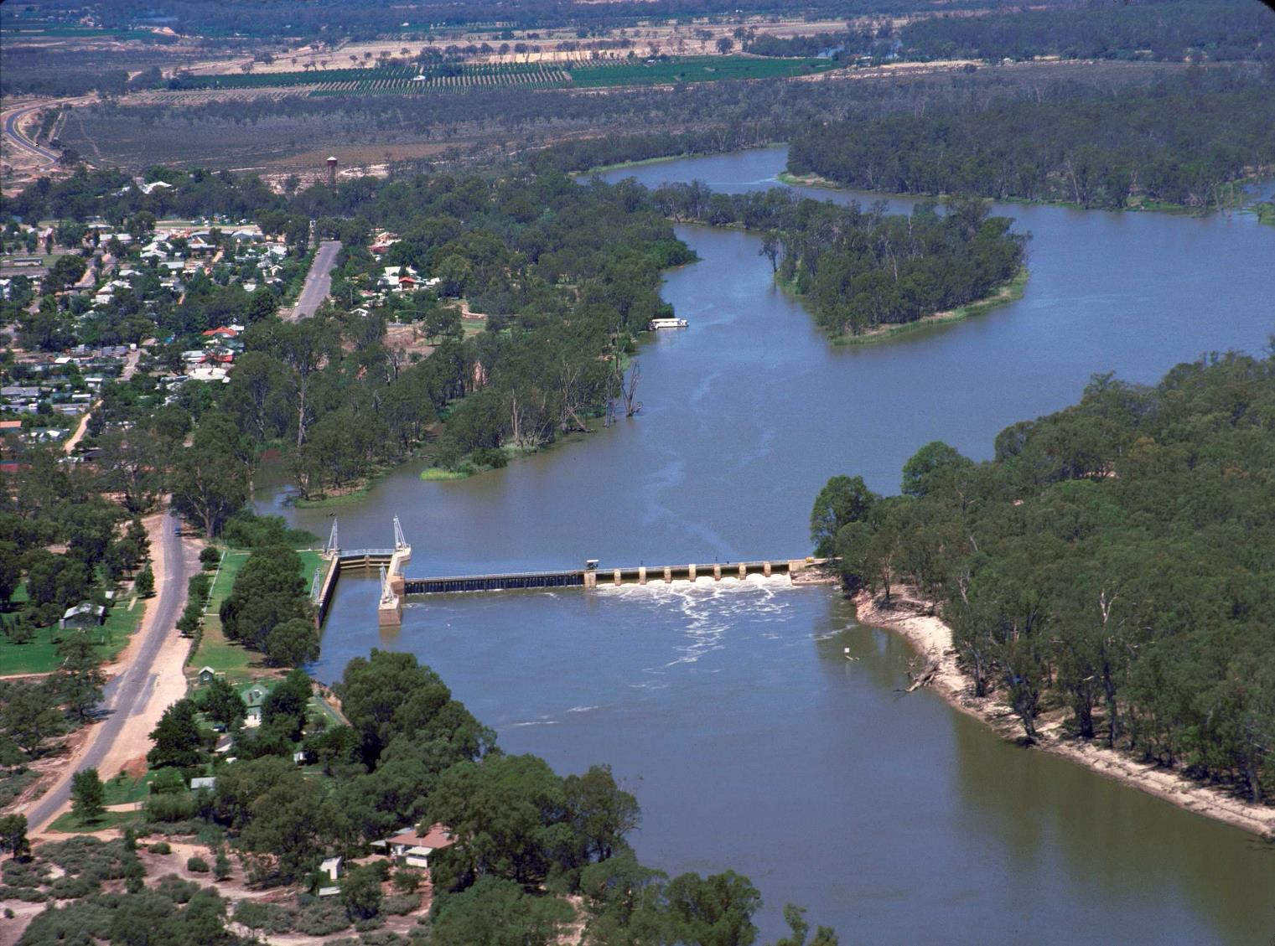
Notes:
We built weirs and locks in the lower river to enable navigation to compensate for the water taken out in the upper river. The weirs and locks were the first of the negotiated “mitigation strategies” for the impacts of human activity. They did not recognise the natural environment.

Slide 9
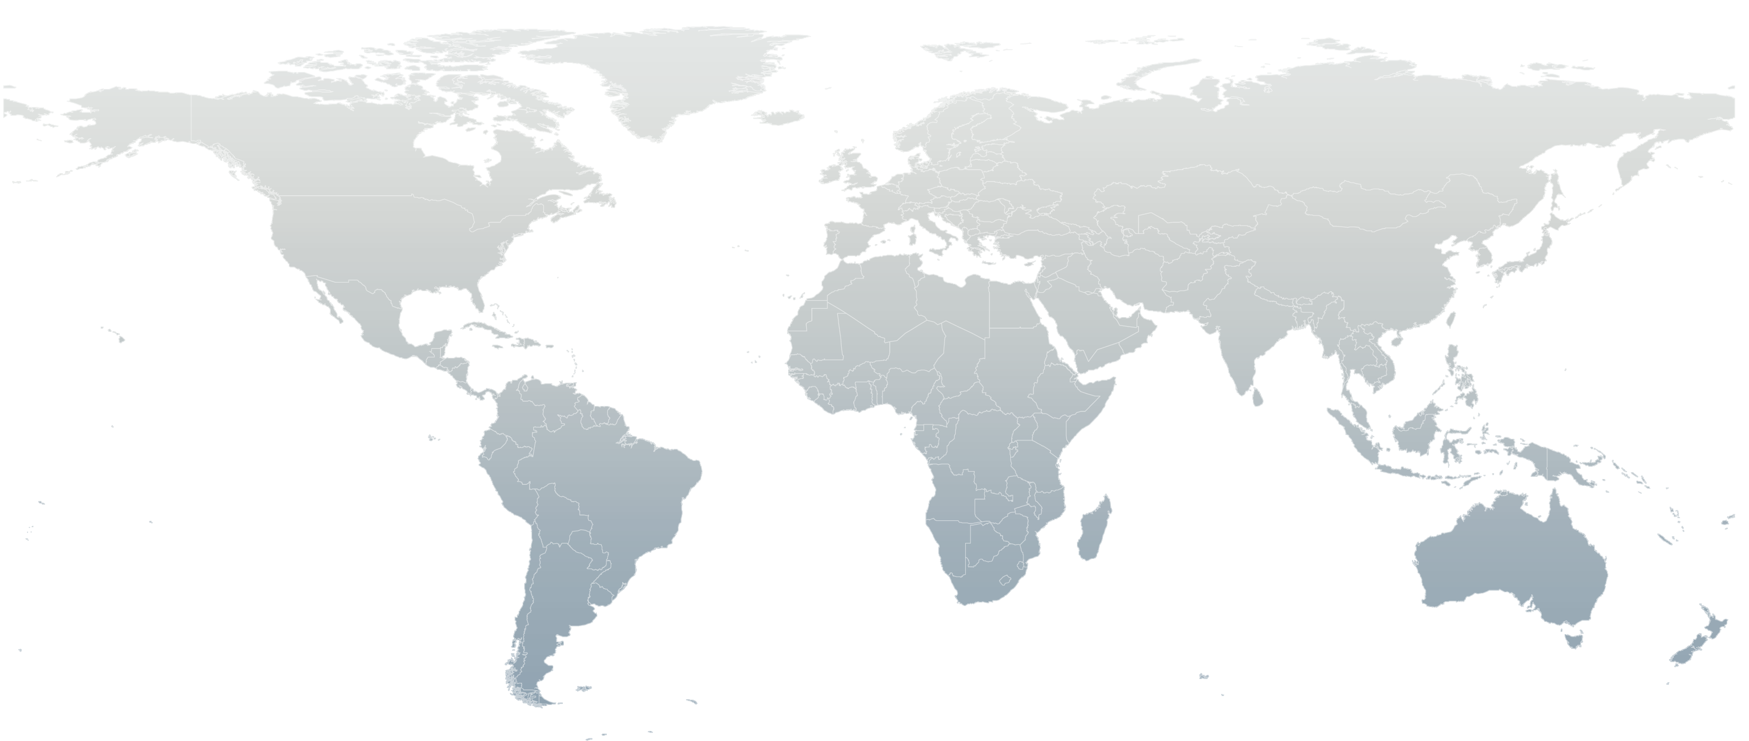
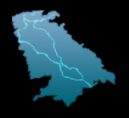
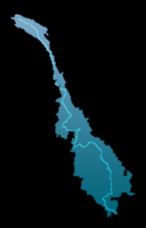
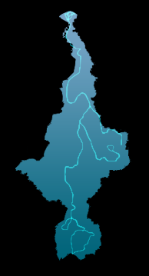
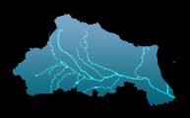
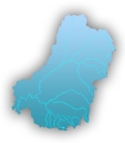
The Basins – Murray-Darling / Africa & Asia
The clash of PERCEPTION vs FACT
Euphrates
Indus
Ganges
Mekong
Nile
Murray-Darling

Slide 10
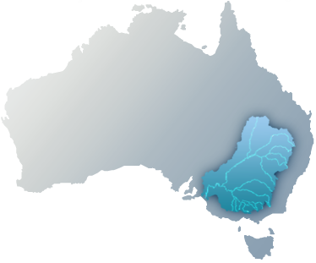
The Murray-Darling Basin
Driving Philosophy: You can’t manage what you can’t measure and discribe
Must move from perceptions to fact
“Sufficient certainty” enables the hard questions and tradeoffs to be tackled

Slide 11
The Australian Story
Murray Darling Basin as the main example but it applies to most developed River systems
Notes:
Add map as background?

Slide 12
Understand what it is you seek to manage or change

Slide 13
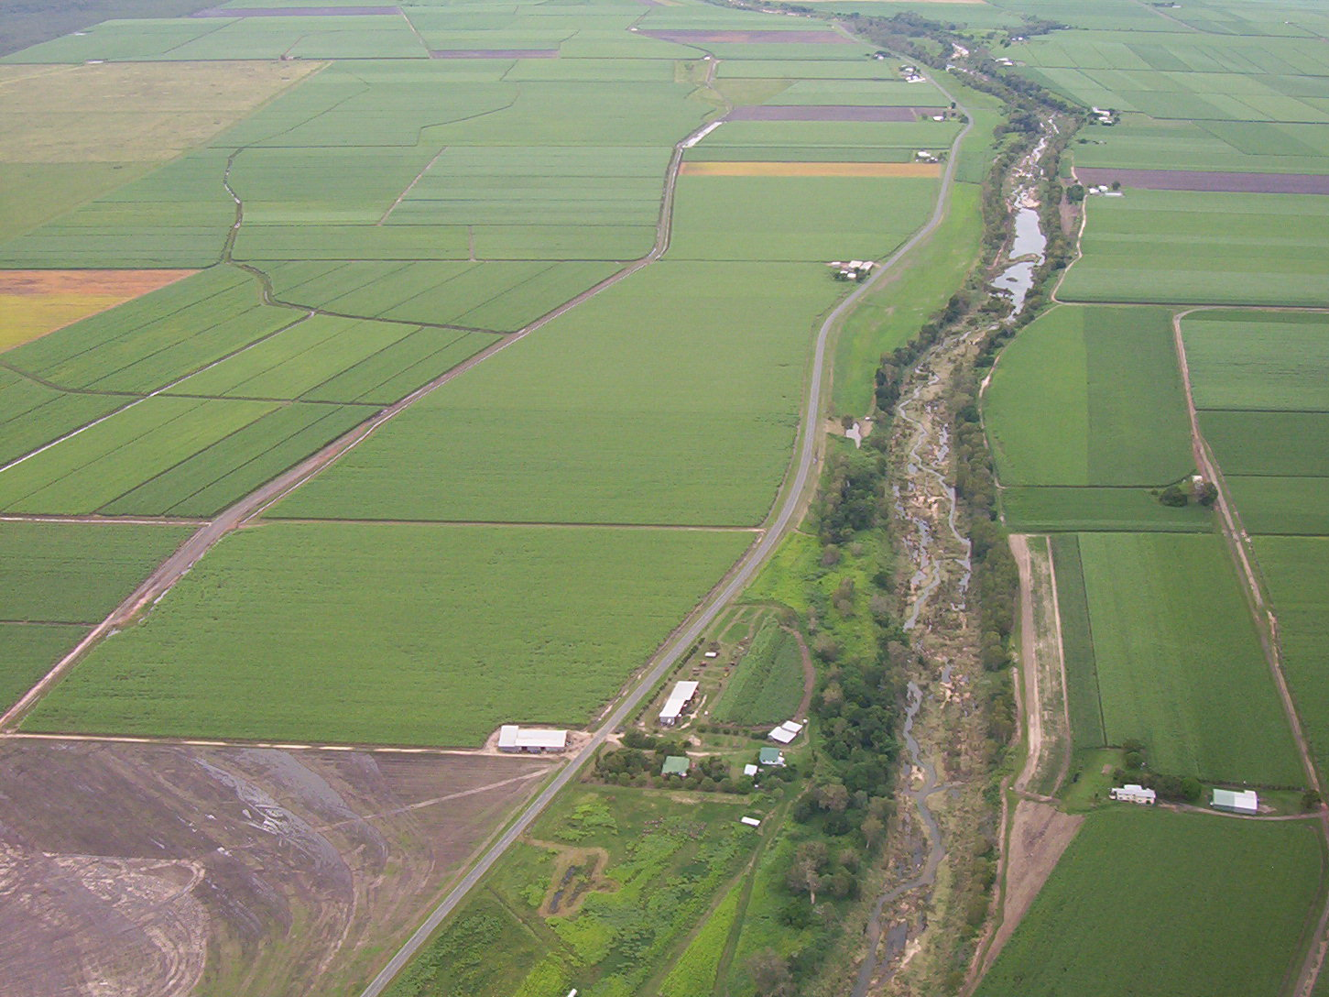
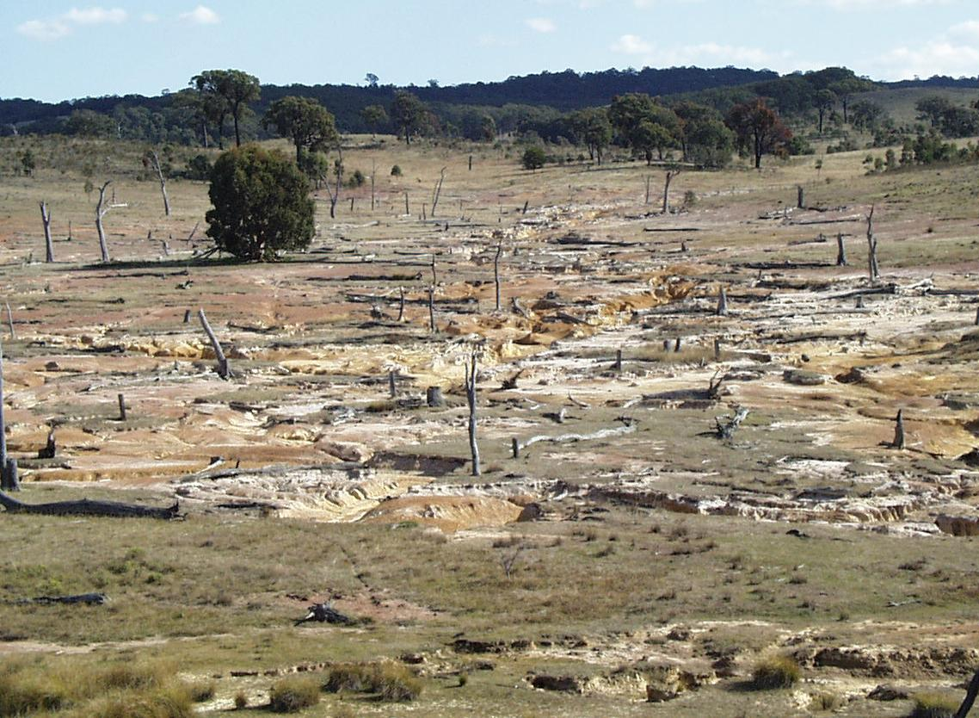
Australia’s top 3 water issues
1. Diminishing water security
Climate change and drought
Urban population growth
2. Over-allocation of resources
Rapid and poorly managed expansion of irrigation (1960s-1980s)
Uncontrolled groundwater use
Drier climate since 1950s
3. Environmental degradation
Salinity
Toxic algal blooms
Decline in native fish, birds and floodplain vegetation

Slide 14
Murray Darling Basin-4 Priority Issues
Issue1. Over allocation of water
Issue 2.Rising river and Land salinization
Issue 3. Irrigation areas not financially sustainable
Issue4.Environmental flows for rivers
Notes:
In 1978 there were 214 international river basins. With the break-up of the Soviet union and Balkan states, there are now 261.
These rivers cover 45.3 percent of the land surface of the earth, and carry 80 percent of its available fresh water. They include parts of 145 nations. 21 nations, such as Bangladesh, lie entirely within a shared basin. Tensions and disputes are inevitable, with national interest so hard to define. Water, or even sediment, used or diverted in your country, upstream, is not available for me, struggling downstream, and I am likely to get rather tight jawed over your plans to develop it.
The negative vision for catchment management that we often see is communities looking towards the mountains but rarely towards the sea.

Slide 15
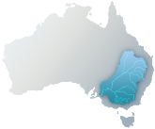
The Murray-Darling Basin
70% of Australia’s irrigated agriculture
However...
Serious over-allocation of water between 1960s-1980s
10500
The Cap

Slide 16
Key Characteristics of the “CAP”
Sound knowledge base about water use--who is entitled to use and who is entitled to change it
All Rivers modelled –can test scenarios
Equity between States and Sectors-social and political equity
Dispute resolution mechanism outside the “COURT SYSTEM”
Audited annually to ensure compliance and “TRUST”

Slide 17
managing salt pollution
Salinity and Drainage Strategy
(Policy-Institutions-Instruments-Tools)

Slide 18
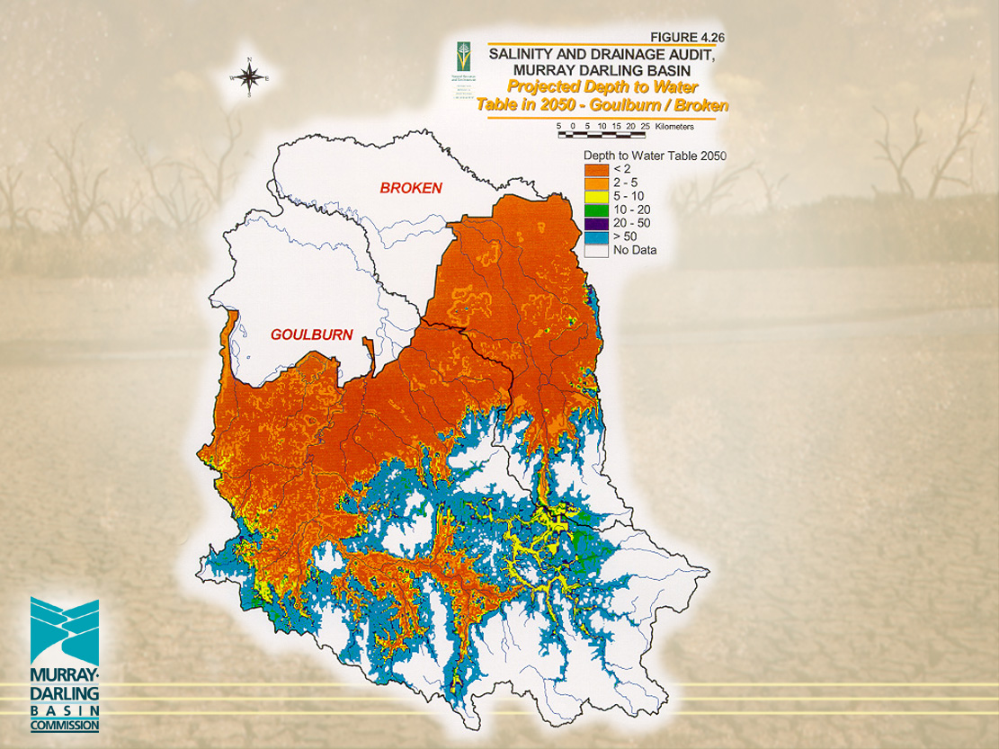

Slide 20
River Salinities - New South Wales
Average River Salinity (EC)
River Valley
Current
2020
2050
2100
Murrumbidgee
250
320
350
400
Lachlan
Forbes
530
780
1150
1460
Darling
Menindee
360
430
490
530
Bogan
730
1500
1950
2320
Macquarie
620
1280
1730
2110
Castlereagh
640
760
1100
1230
Namoi
680
1050
1280
1550
Gwydir
560
600
700
740
Macintyre
450
450
450
450
Notes:
Evidence of decline includes the snapshot of river health
bit of a focus on Stakeholder Profiling - as it relates to this session of the Seminar

Slide 21
Future Dryland Salinity
Land area with high potential to develop
dryland salinity in Australia.
Land Area (ha)
State/Territory*
1998/2000
2050
NSW
181 000
1 300 000
Vic
670 000
3 110 000
Qld
Not assessed
3 100 000
SA
390 000
600 000
Sub Total
1 241 000
8 110 000
WA
4 363 000
8 800 000
Tas
54 000
90 000
Total
5 658 000
17 000 000
Source: National Land and Water Resources Audit
Notes:
Land area salt-affected is the common measure of salinity impact
First, remove from your mind the image of salinity as cancerous salt scald - this is not a doomsday scenario
These figures are for areas where agricultural productivity is affected - the predictive modelling can’t distinguish water logging and salinity in many cases
Note the large area for Western Australia where prediction is best - other States may revise upwards.

Slide 22
Salinity Strategy in Summary
State salinity Strategies
Farming systems development
Forestry for Environmental Services
End of valley target site
Farming Systems Development
Joint works to protect shared rivers
Catchment Management Strategy
Morgan salinity target <800EC 95% of time
Irrigation and land and water management plan
Forestry for environmental services
Joint works to protect shared rivers
Notes:
Farming Systems Development
R&D agenda for farming systems capable of mimicking natural vegetation in water use.
Forestry for environmental services
Vegetation bank and financial investment vehicles for targeting public funds and maximising leverage on private capital
For salinity prone areas (600-800mm) but carefully sited
Integrated with carbon sequestration
Joint works for shared rivers
More salt interception schemes over 10 years
So lets examine ICM more closely

Slide 23
Irrigation Areas not Financially Sustainable
Outcome;
5 years of detailed work and assessment (knowledge base)
Engagement with the irrigation industry and farmer groups
Corporatisation/Privatisation of the Irrigation Areas (self management)(extremely hard for Government to let them go!!)
Government Licenses water availability at major offtakes and provides some financial support for environmental matters

Slide 24
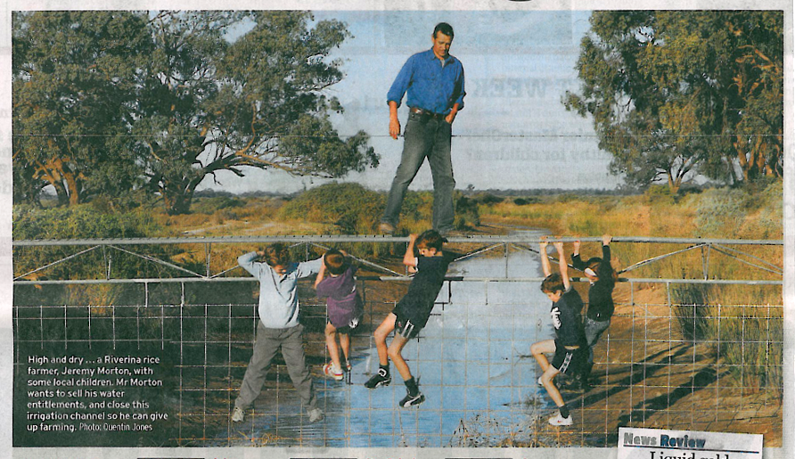
1. Water rights and water trading
Water rights and water trading
Tradeable rights
Legal property title (separated from land title)
Differing levels of security (higher and lower reliability)
Entitlement (volumetric) – perpetual
Allocation (share of available water) – seasonal/annual
Storage and supply (capacity share) – new, in some areas only
Cross-border trade, with some restrictions (being removed)
Spot market with water trading brokers

Slide 25
Integrated surface-water and groundwater use

Slide 26
Improving the Health of our Rivers-Policy to Action (evidenced based Policy)

Slide 27
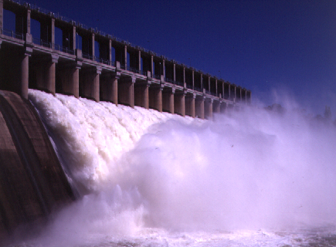
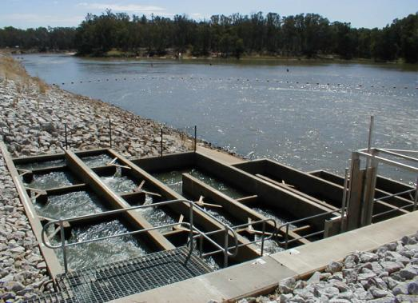
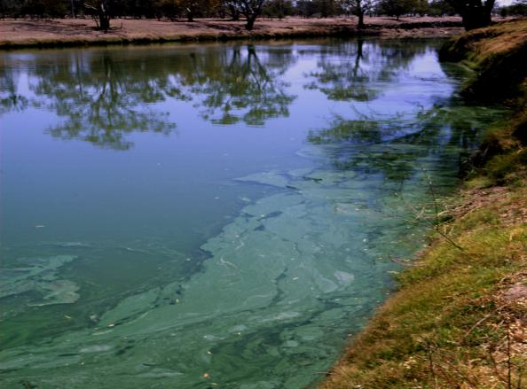
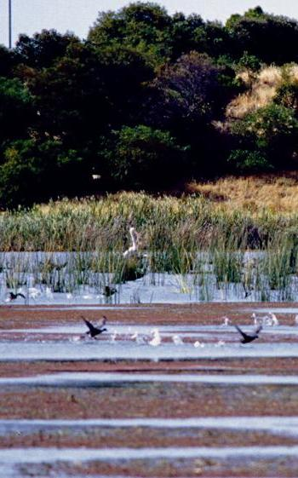
Better environmental outcomes

Slide 28
The Murray-Darling Basin Plan (2010-11)
Defines ‘Sustainable Diversion Limits’
For 20 River Valleys in MDB (in different States)
Covers surface- and ground-waters
Will consider climate change risks
Protect environmental ‘assets’
Floodplain forests and wetlands
Environmental flows
Water quality and salinity
Political and social implications
State ‘Water Sharing Plans’ must be accredited
Social impacts must be considered
Based on ‘best-available’ science (evidence-based policy)

Slide 29
National water policy reform (1994-2004)
1994 COAG water reforms
Institutional reform (rural and urban)
Property rights and water markets/trading
Environmental flow provisions
Groundwater management
Water included in National Competition Policy
2004 National Water Initiative
Review and update of 1994 reforms
New powers and role for Commonwealth (Federal) Government
New Commonwealth Water Act (2007)
Water for the Future fund ($12.9 billion)
Murray-Darling Basin Plan

Slide 30
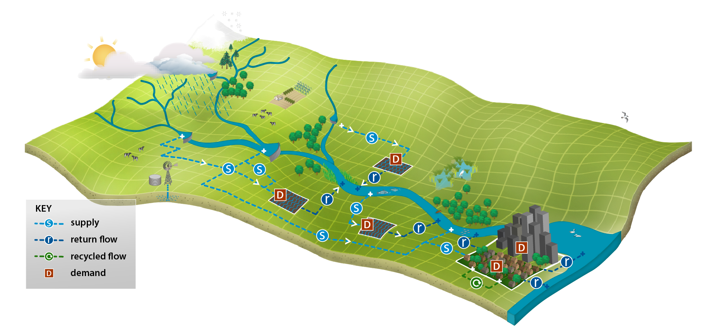
Integrated modelling system (IMS) for rural and urban water management
LAND USE
CLIMATE
ECOLOGICAL ASSETS
DAMS & WEIRS
IRRIGATION
CITIES

Slide 31
management
Conventional River Basin
Knowledge Knowledge
Policy Process
Implementation Personality
On Ground Action

Slide 32
The Basins – Murray-Darling / Africa & Asia
The clash of PERCEPTION vs FACT
Euphrates
Indus
Ganges
Mekong
Nile
Murray-Darling

